Slide 1
Logistic Regression
Eric Harley
XBUS 504 – Fall 2018
GSCS

Slide 2
Logistic Regression
In linear regression, we used a set of input variables (Covariates, features) to predict the value of a continuous response variable.
In logistic regression, we use a set of input variables to predict probabilities of a dichotomous (0/1) response.

Slide 3
Logistic Regression
When performing linear regression, we use the following function:
When performing logistic regression, we use the following form:
Probability of y = 1, given x

Slide 4
Logistic Regression
Create a plot of the logistic function.
How would you describe the shape of the function?

Slide 5
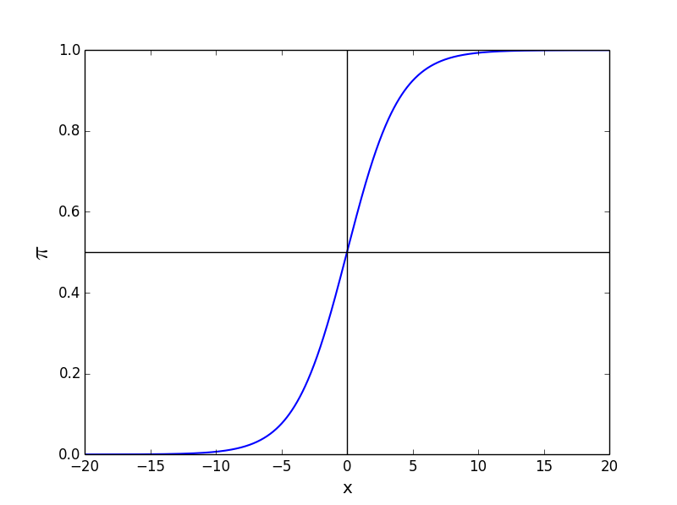
Logistic Regression
The logistic function takes on an “S” shape, where y is bounded by [0,1]
Notes:
You want to return a value between 0 and 1 for all possible values of x, because probability less than 0 or greater than 1 does not make sense. However, this would be the case for a linear regression.

Slide 6
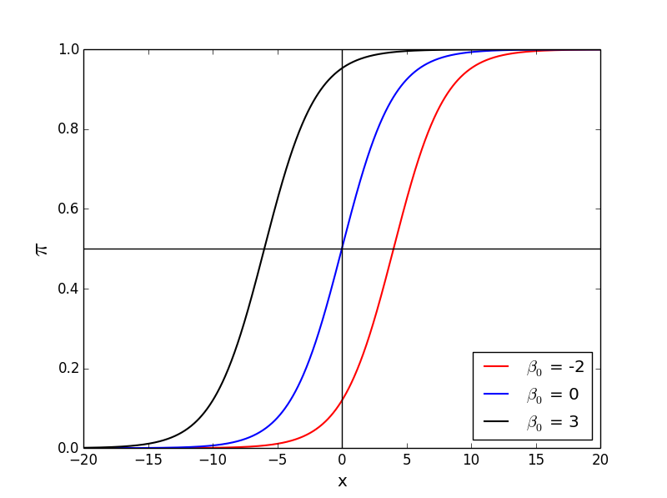
Logistic Regression
Changing the β₀ value shifts the function horizontally.

Slide 7
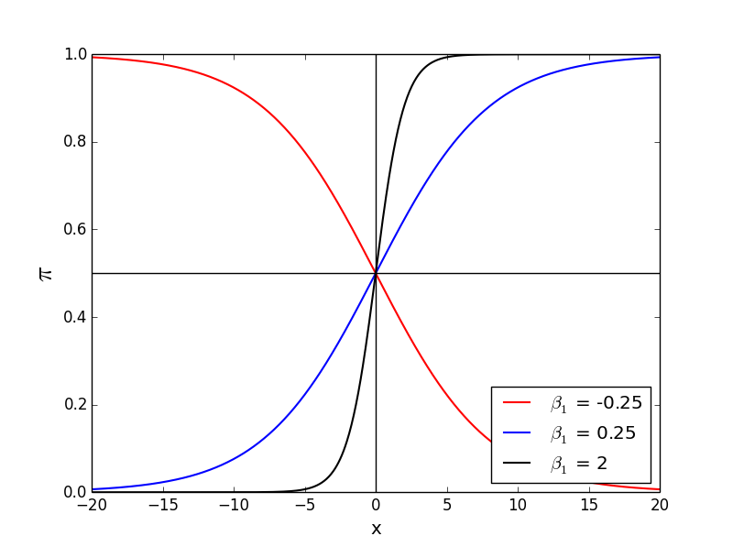
Logistic Regression
Changing the β₁ value changes the slope of the curve

Slide 8
Logistic Regression
In order to interpret the outputs of a logistic function we must understand the difference between probability and odds.
The odds of an event are given by the ratio of the probability of the event by its complement:
Notes:
Q: What is the range of probability?
Q: What is the range of the odds ratio?

Slide 9
Logistic Regression
Quiz: You’re trying to determine whether a sales lead will convert to a sale or not. The conversion rate is 33.33%. What are the odds that a lead will convert?
Notes:
This means that for every customer that converts you will have two customers that do not convert

Slide 10
Logistic Regression
Watch what happens when we take the odds ratio of the logistic function

Slide 11
Logistic Regression
The logarithm of the odds is a linear equation!
Notes:
The process we just went through is known as the logit transformation. The output form is referred to as the logit function and also the log-odds function.
This simple relationship between the odds ratio and the parameter β is what makes logistic regression such a powerful tool.

Slide 12
Logistic Regression
In linear regression, the parameter β₁ represents the change in the response variable for a unit change in x.
In logistic regression, β₁ represents the change in the log-odds for a unit change in x.
This means that gives us the change in the odds for a unit change in x.

Slide 13
Logistic Regression
Q: How to determine whether a coefficient is significant?
A: p-value

Slide 14
Logistic Regression
Example: Suppose we are interested in mobile purchase behavior. Let y indicate purchase/no purchase, and let x indicate whether the phone was an iPhone.
Logistic regression gives β₁ = 0.693.
Q: What does this mean?
Notes:
In this case the odds ratio is exp(0.693) = 2, meaning the likelihood of purchase is twice as high if the phone is an iPhone.

Slide 15
Logistic Regression
Can easily extend the definition to include multiple covariates…
Logit function
Logistic function
Notes:
The logistic regression equation

Slide 16
Logistic Regression
This data set contains 10,000 records associated with credit card accounts with the following four fields:
Default | Binary variable indicating whether the credit card holder defaulted on their credit card obligations
Student | Binary variable indicating whether the credit card holder is a student
Balance | Continuous variable recording the credit card holders current outstanding balance
Income | Continuous variable representing the total annual income for the credit card holder

Slide 17
Logistic Regression
Part I: Exploration
Read in Default.csv and convert all data to numeric
Split the data into train and test sets
Create a histogram of all variables
Create a scatter plot of the income vs. balance
Mark defaults with a different color (and symbol)
What can you infer from this plot?

Slide 18
Logistic Regression
Part II: Logistic Regression
Run a logistic regression on the balance variable
Is the β value associated with balance significant?
Predict the probability of default for someone with a balance of $1.2k and $1.5k
Plot the fitted logistic function overtop of the data points
Create predictions using the test set

